Slide 1
Text mining
Ali Youssef Ali
18101591

Slide 2
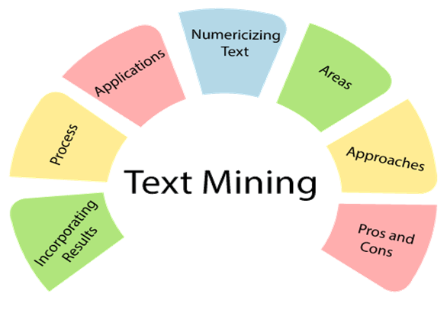

Slide 3
What is Text mining
Text mining is the process of exploring and analyzing large amounts of unstructured text data aided by software that can identify concepts, patterns, topics, keywords and other attributes in the data.

Slide 4


Slide 5
What is natural language processing?
Natural language processing (NLP) refers to the branch of computer science—and more specifically, the branch of artificial intelligence or AI—concerned with giving computers the ability to understand text and spoken words in much the same way human beings can.

Slide 6
NLP tasks
Sentiment analysis attempts to extract subjective qualities—attitudes, emotions, sarcasm, confusion, suspicion—from text.

Slide 7
NLP tasks
Speech recognition, also called speech-to-text, is the task of reliably converting voice data into text data. Speech recognition is required for any application that follows voice commands or answers spoken questions. What makes speech recognition especially challenging is the way people talk—quickly, slurring words together, with varying emphasis and intonation, in different accents, and often using incorrect grammar.

Slide 8
NLP tasks
Part of speech tagging, also called grammatical tagging, is the process of determining the part of speech of a particular word or piece of text based on its use and context. Part of speech identifies ‘make’ as a verb in ‘I can make a paper plane,’ and as a noun in ‘What make of car do you own?’

Slide 9
NLP tasks
Word sense disambiguation is the selection of the meaning of a word with multiple meanings through a process of semantic analysis that determine the word that makes the most sense in the given context. For example, word sense disambiguation helps distinguish the meaning of the verb 'make' in ‘make the grade’ (achieve) vs. ‘make a bet’ (place).

Slide 10
NLP tasks
Named entity recognition, or NEM, identifies words or phrases as useful entities. NEM identifies ‘Kentucky’ as a location or ‘Fred’ as a man's name.

Slide 11
NLP tasks
Co-reference resolution is the task of identifying if and when two words refer to the same entity. The most common example is determining the person or object to which a certain pronoun refers (e.g., ‘she’ = ‘Mary’), but it can also involve identifying a metaphor or an idiom in the text (e.g., an instance in which 'bear' isn't an animal but a large hairy person).

Slide 12
NLP tasks
Natural language generation is sometimes described as the opposite of speech recognition or speech-to-text; it's the task of putting structured information into human language.

Slide 13
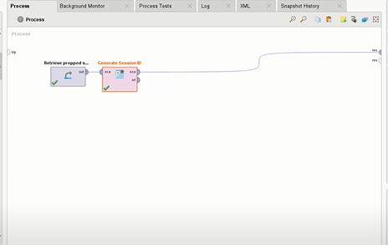

Slide 14
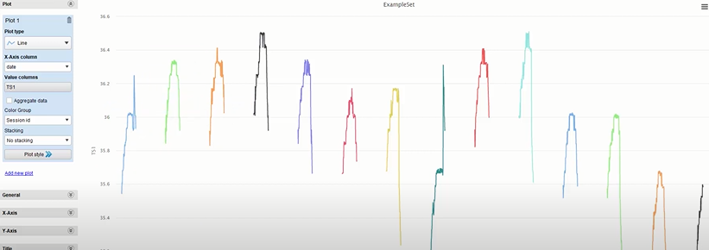

Slide 15
References
https://data-flair.training/blogs/text-mining/
https://en.wikipedia.org/wiki/Text_mining

